Slide 1
Computer Vision
Part 1: Object Localization
ADF – Start 08:30

Slide 2

Agenda
Part 1: Object Localization
Part 2: Classical Object Detection
Part 3: Two-Stage Object Detection
Part 4: One-Stage Object Detection
Computer Vision

Slide 3
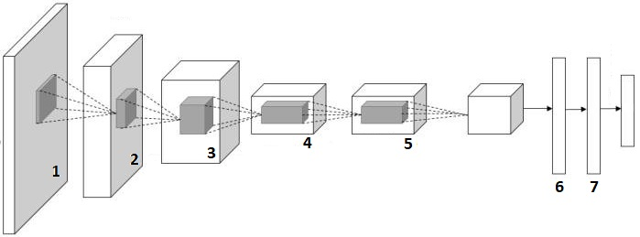
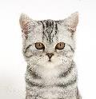
So far
Fully-Connected
c-class scores
[224x224x3]
Vector:4096
Computer Vision

Slide 4
Image Classification Tasks
Image Segmentation
Instance Segmentation
Recognition and Identification
Image Classification
Object Annotation
Content-based Image Retrieval
Objects Detection
Objects Localization
Image Captioning
Pose Estimation
Computer Vision

Slide 5
Image Classification Tasks
Image Segmentation
Instance Segmentation
Recognition and Identification
Image Classification
Object Annotation
Content-based Image Retrieval
Objects Detection
Objects Localization
Image Captioning
Pose Estimation
Computer Vision

Slide 6
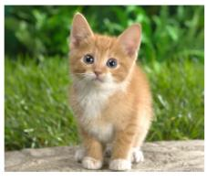
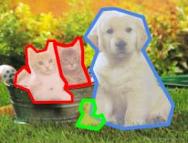

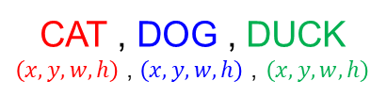

Computer Vision Tasks
Classification
+ Localization
Instance
Segmentation
Classification
Object Detection
CAT
CAT
$$x,y,w,h$$
CAT , DOG , DUCK
$\left(x,y,w,h\right)$ , $\left(x,y,w,h\right)$ , $\left(x,y,w,h\right)$
CAT, DOG, DUCK
Single Object
Multiple Objects
Computer Vision

Slide 7
Classification
Input : Image,
there may be an object inside
Output : Class Label
Single object per image
Evaluation metric:
Accuracy, F1, Precision, etc.
Also called Recognition, Identification
CAT
Computer Vision

Slide 8
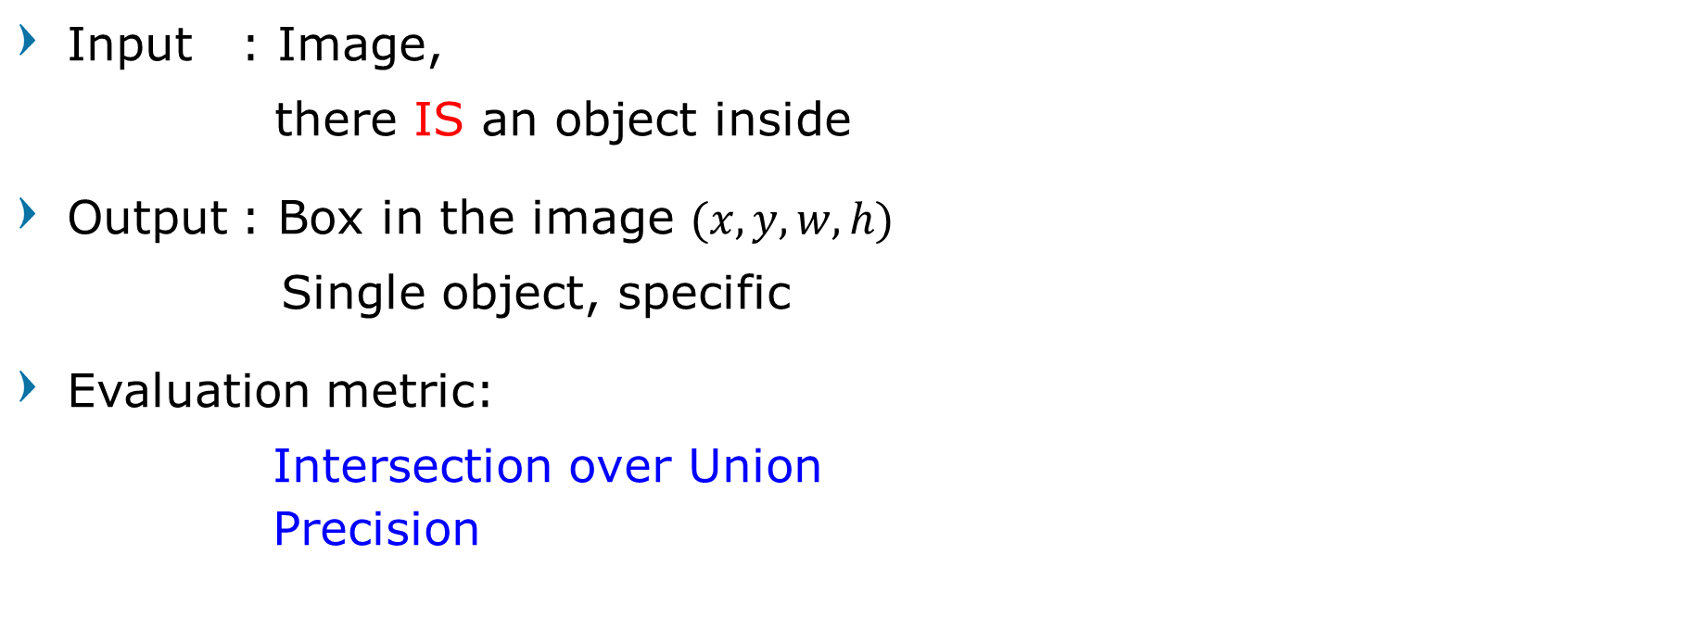

Localization
Input : Image,
there IS an object inside
Output : Box in the image $(x, y, w, h)$
Single object, specific
Evaluation metric:
Intersection over Union Precision
$$(x, y, w, h)$$
Computer Vision

Slide 9
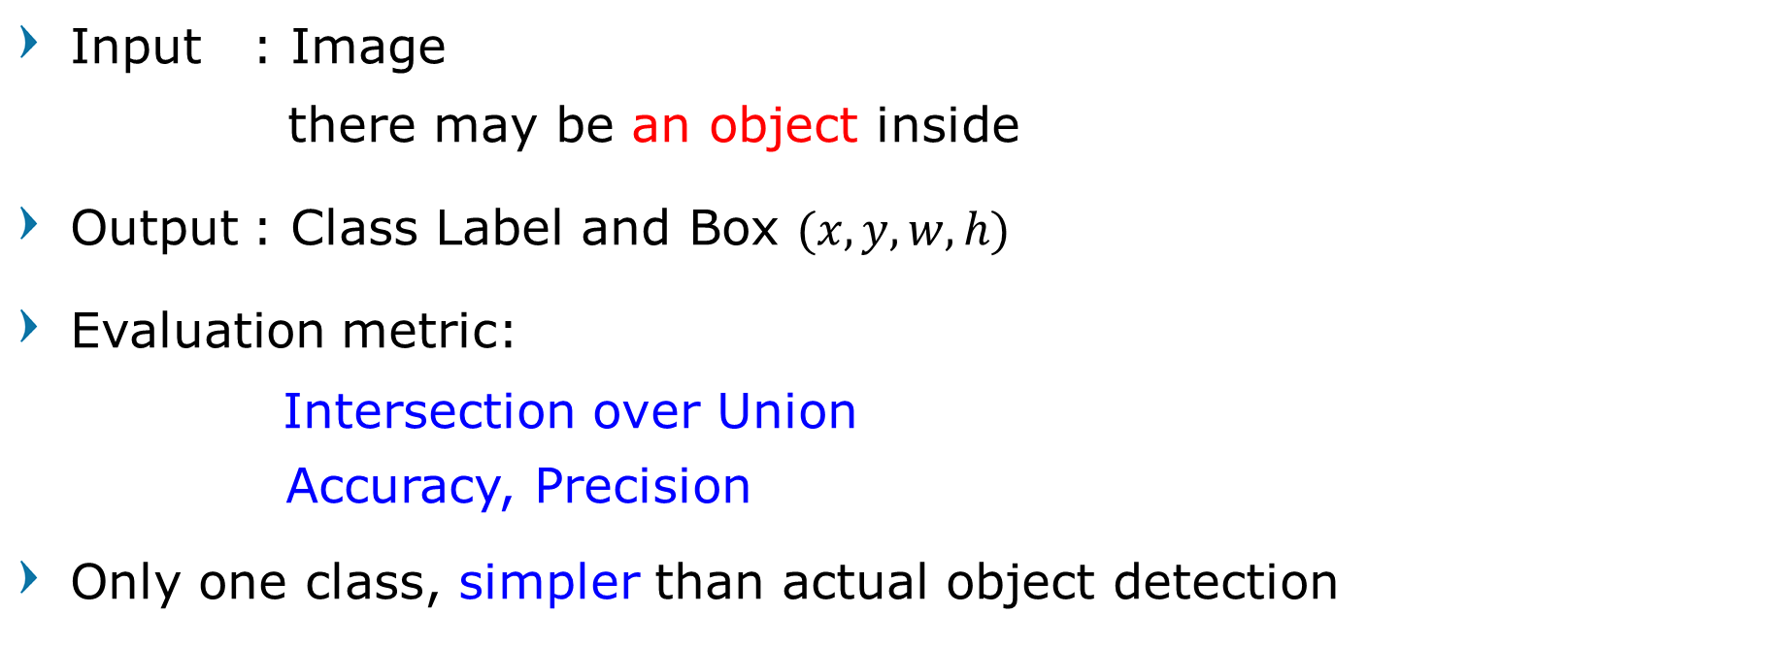
Classification + Localization (Object Localization)
Input : Image
there may be an object inside
Output : Class Label and Box $(x, y, w, h)$
Evaluation metric:
Intersection over Union
Accuracy, Precision
Only one class, simpler than actual object detection
CAT
$$(x, y, w, h)$$
Computer Vision

Slide 10
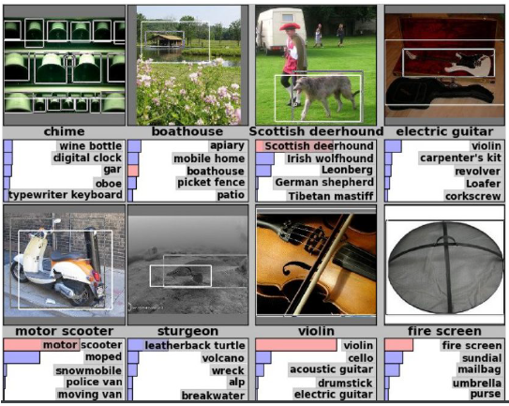
Classification + Localization : ImageNet
1000 classes
Same as classification
Each image has 1 class, at least one bounding box
~800 training images per class
Computer Vision

Slide 11
Classification + Localization : ImageNet
Submission:
Algorithm produce 5 guesses (class and box)
Example is correct if :
One of five guesses has the correct class, AND
Bounding box at least 0.5 intersection over union (IoU)
Computer Vision

Slide 12

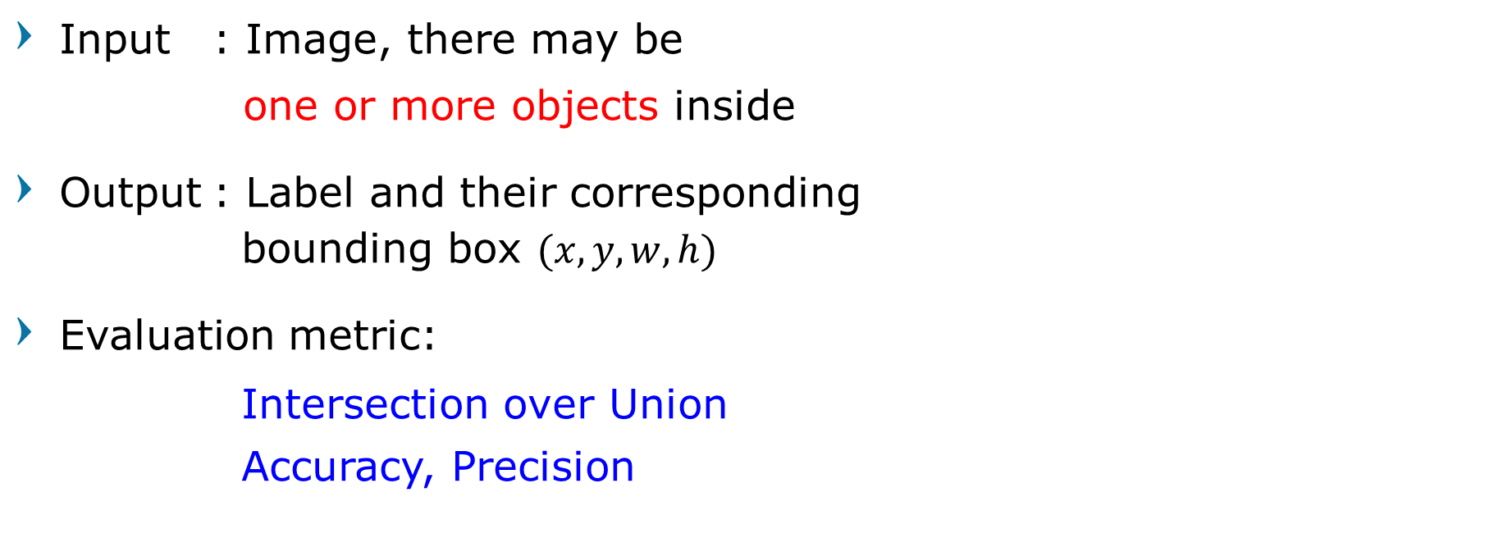
Object Detection
Input : Image, there may be
one or more objects inside
Output : Label and their corresponding bounding box $(x, y, w, h)$
Evaluation metric:
Intersection over Union
Accuracy, Precision
CAT, CAT , DOG , DUCK
$$\left(x,y,w,h\right) \text{,} \left(x,y,w,h\right)$$
$$\left(x,y,w,h\right)\text{ ,} \left(x,y,w,h\right)$$
Computer Vision

Slide 13
Object Detection Tasks
Localization
Recognition + bounding box (coordinates)
Single or fixed number of object per image
Object Detection
Multiple Objects Localization
Classical approach usually focuses on Specific class (Human Detection, Face Detection, etc.)
Modern approach deals with Multi-class Objects Detection
Computer Vision

Slide 14
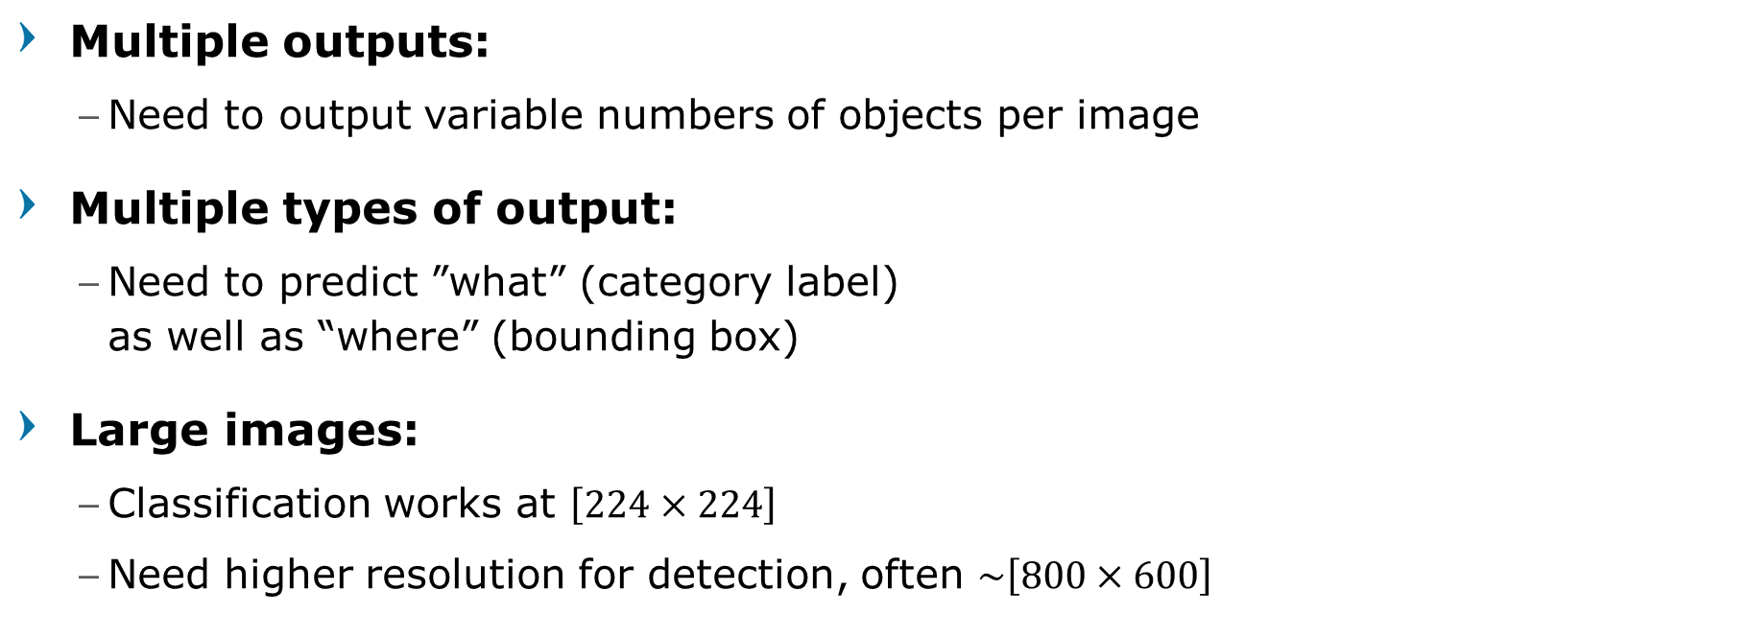
Object Detection: Challenges
Multiple outputs:
Need to output variable numbers of objects per image
Multiple types of output:
Need to predict ”what” (category label) as well as “where” (bounding box)
Large images:
Classification works at $\left[224×224\right]$
Need higher resolution for detection, often $\sim \left[800×600\right]$
Computer Vision

Slide 15

Computer Vision Tasks
Classification
+ Localization
Instance
Segmentation
Classification
Object Detection
Computer Vision

Slide 16
How to solve Single Object Localization?
Computer Vision

Slide 17
Localization as a Classification (Sliding Window)
Computer Vision

Slide 18
Recognizing via Template Matching
Image patch
Find the chair in this image
Output of normalized correlation
Computer Vision

Slide 19
Recognizing via Template Matching
Image patch
Find the chair in this image
Output of normalized correlation
Not so Great
Computer Vision

Slide 20
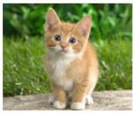

Localization as a Classification
Use pretrained model for classification that receive small sized input
$$50×50$$
Computer Vision

Slide 21
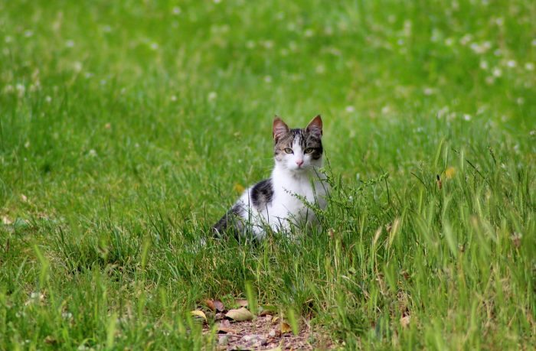

Localization as a Classification
Test on bigger image
Sliding window classification
 |  |  | 6 | 7 | 8 | 7
 |  |  | 7 | 8 | 9 | 8
 |  |  | 8 | 9 | 9 | 8
 |  |  | 7 | 8 | 8 | 7
$$200×200$$
Problem?
Computer Vision

Slide 22
Localization as a Classification
Size dependent
Stride dependent
Slow Test time
Bounding box not accurate
Multiclass decision
Perhaps don’t do this?
Computer Vision

Slide 23
Localization as a Regression
Computer Vision

Slide 24

Classification + Localization
correct label
CAT
Treat localization as a regression problem!
FC 4096 to 1000
c-class scores
Softmax Loss
Vector: 4096
Multitask Loss
Loss
ImageNet pretrained model
Box coordinates
L2 Loss
FC 4096 to 4
$$(x, y, w, h)$$
correct box
(x’,y’,w’,h’)
Computer Vision

Slide 25
Localization + Pretrained Classification
Step 1: Train (or download) a classification model
AlexNet or VGG or GoogLeNet or any other “popular-Net”
Fully-connected layer
Conv
Net
Softmax loss
4096
Final conv feature map
image
Class scores
Computer Vision

Slide 26
Localization + Pretrained Classification
Step 2: Detach the classification layer
Classification Head
Fully-connected layer
Conv
Net
Softmax loss
4096
Final conv feature map
image
Class scores
Computer Vision

Slide 27
Localization + Pretrained Classification
Step 3: attach new fully-connected “regression head”
Fully-connected layer
“classification head”
Class score
Conv
Net
Fully-connected layer
4096
Final conv feature map
image
“regression head”
Box coordinates
Computer Vision

Slide 28
Localization + Pretrained Classification
Step 4: (re) train the regression head only
Using SGD and L2 loss
Fully-connected layer
FIXED
“classification head”
Class score
Conv
Net
Fully-connected layer
4096
Final conv feature map
image
L2 loss
TRAIN
Box coordinates
Computer Vision

Slide 29
Localization + Pretrained Classification
Test Time: reattach classification head, use both heads at test time
Fully-connected layer
Class scores
Conv
Net
Fully-connected layer
4096
Final conv feature map
image
Box coordinates
Computer Vision

Slide 30


Class Agnostic vs Specific Regression
Assume classification over C classes
Fully-connected layer
Classification head:
$C$ numbers
Class agnostic:
$4$ numbers
One box for any class
Class specific:
$C×4$numbers
One box per class
Class scores
Conv
Net
Fully-connected layer
4096
Final conv feature map
image
Box coord
Computer Vision

Slide 31
Regression Head Location
After conv layers
OverFeat, VGG
After last FC layer
DeepPose, R-CNN
Fully-connected layer
Conv
Net
Softmax loss
4096
Final conv feature map
image
Class scores
Computer Vision

Slide 32
Efficient Sliding Window
OverFeat
Computer Vision

Slide 33
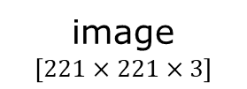




Turning FC layer into Conv Layer
$$\left[4096×4096\right]=16M$$
4096
4096
Conv
Net
FC
FC
FC
image
$$\left[221×221×3\right]$$
feature map
$$5×5×1024$$
class scores:
1000
$$\left[25600×4096\right]=104M$$
$$\left[4096×1000\right]=4M$$
[Sermanet et al, “Integrated Recognition, Localization and Detection using Convolutional Networks”, ICLR 2014]
Computer Vision

Slide 34








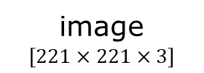

Turning FC layer into Conv Layer
$$4096∗\left[1×1\right]=4096$$
4096 filters
@$5×5$ conv
4096 filters
@$1×1$ conv
1000 filters
@$1×1$ conv
Conv
Net
$$1×1×4096$$
$$1×1×4096$$
class scores:
$$1×1×1000$$
image
$$\left[221×221×3\right]$$
feature map
$$5×5×1024$$
$$4096∗\left[5×5\right]=104K$$
$$1000∗\left[1×1\right]=1000$$
Less Parameters = GOOD
[Sermanet et al, “Integrated Recognition, Localization and Detection using Convolutional Networks”, ICLR 2014]
Computer Vision

Slide 35
What is another benefit of using Conv layer from top to bottom?
Computer Vision

Slide 36
Dense Layer
What happened if we want to feed larger/smaller input into an already trained FC Layer?
-
-
-
Output layer
Input layer
Hidden
Layer 1
Hidden
layer 2
Computer Vision

Slide 37
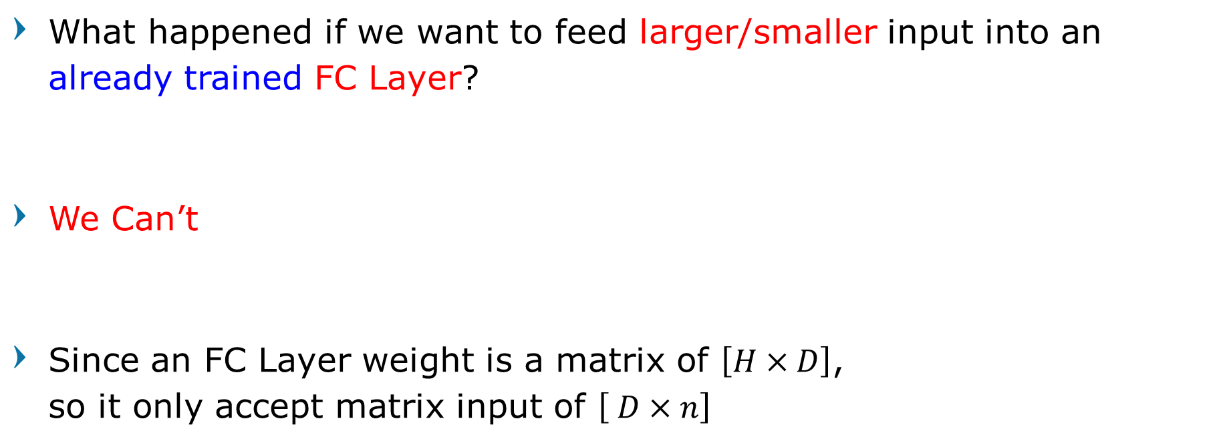
Dense Layer
What happened if we want to feed larger/smaller input into an already trained FC Layer?
We Can’t
Since an FC Layer weight is a matrix of $\left[H×D\right]$, so it only accept matrix input of $\left[ D×n\right]$
Computer Vision

Slide 38
Convolution Layer
What happened if we want to feed larger/smaller input into an already trained Convolution Layer?
Computer Vision

Slide 39
Convolution Layer
What happened if we want to feed larger/smaller input into an already trained Convolution Layer?
Since the weights in Conv Layer are its filters, then different-sized inputs only yield to different-sized outputs
Computer Vision

Slide 40







Convolution Layer
$$3×3$$
$$1×1$$
$$5×5$$
$$3×3$$
$$3×3$$
$$7×7$$
$$5×5$$
Computer Vision

Slide 41
Preserved Spatial Location
Remember that Convolution process preserved the spatial location
Computer Vision

Slide 42
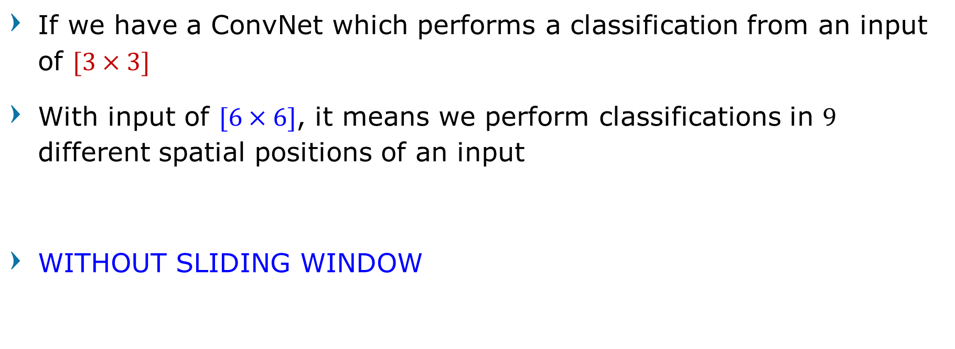
Convolution as Sliding Window
If we have a ConvNet which performs a classification from an input of $[3×3]$
With input of $[6×6]$, it means we perform classifications in $9$ different spatial positions of an input
WITHOUT SLIDING WINDOW
Computer Vision

Slide 43


Sliding Window - OverFeat
4096
4096
FC
FC
FC
class scores:
1000
Conv
Net
feature map
$$5×5×1024$$
FC
FC
image
$$\left[221×221×3\right]$$
FC
1024
Boxes:
1000 x 4
4096
[Sermanet et al, “Integrated Recognition, Localization and Detection using Convolutional Networks”, ICLR 2014]
Computer Vision

Slide 44










Efficient Sliding Window - OverFeat
Efficient sliding window by converting fully-connected layers into convolutions
class scores:
$$1×1×1000$$
$$1×1×4096$$
$$1×1×1024$$
4096 filters
@ $5×5$ conv
1024 filters
@ $1×1$ conv
$1000$ filters
@ $1×1$ conv
Conv
Net
4096 filters
@ $5×5$ conv
1024 filters
@ $1×1$ conv
$4×1000$ filters
@ $1×1$ conv
feature map
$$5×5×1024$$
Bigger image
$$\left[257×257×3\right]$$
$$1×1×4096$$
$$1×1×1024$$
Box coordinates:
$$4×\left[1×1×1000\right]$$
[Sermanet et al, “Integrated Recognition, Localization and Detection using Convolutional Networks”, ICLR 2014]
Computer Vision

Slide 45
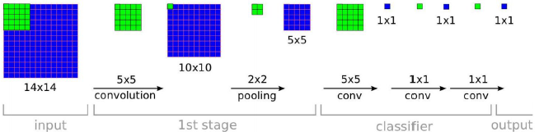

Efficient Sliding Window - OverFeat
Training time:
Small image, basic classifier
$[1× 1× c]$ classifier output
[Sermanet et al, “Integrated Recognition, Localization and Detection using Convolutional Networks”, ICLR 2014]
Computer Vision

Slide 46
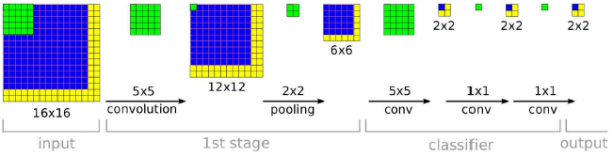
Efficient Sliding Window - OverFeat
Testing time:
Use the classifier to a bigger image
Input image without resizing
[Sermanet et al, “Integrated Recognition, Localization and Detection using Convolutional Networks”, ICLR 2014]
Computer Vision

Slide 47

Efficient Sliding Window - OverFeat
Testing time:
Conv process will output $[2×2× c]$,
only extra compute at yellow regions
[Sermanet et al, “Integrated Recognition, Localization and Detection using Convolutional Networks”, ICLR 2014]
Computer Vision

Slide 48
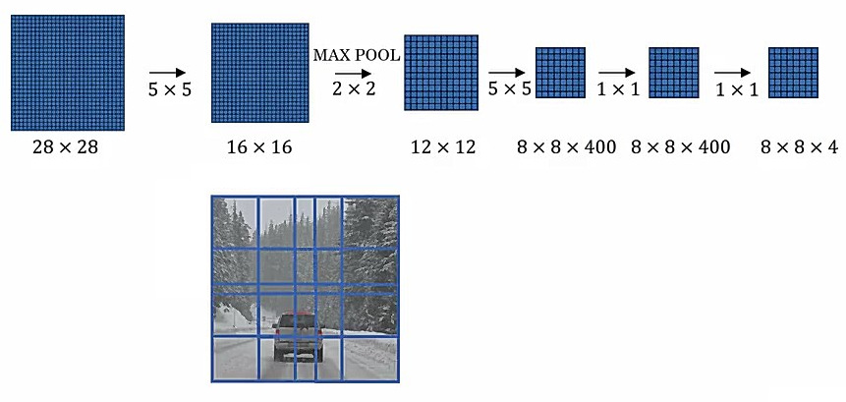
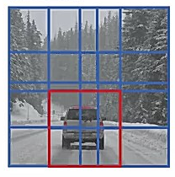
Efficient Sliding Window - OverFeat
14
14
[Sermanet et al, “Integrated Recognition, Localization and Detection using Convolutional Networks”, ICLR 2014]
Computer Vision

Slide 49
Localizing Multiple Parts of an Object
Computer Vision

Slide 50
Localizing Multiple Objects
Localize exactly K-parts of an object in each image
E.g. whole, head, left & right ear → K=4
Fully-connected layer
Class scores
Conv
Net
Fully-connected layer
4096
Final conv feature map
Box coordinates
Kx4 numbers
image
Computer Vision

Slide 51
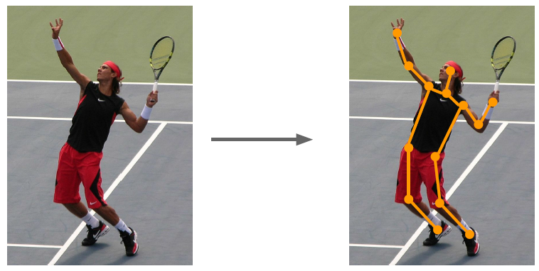
Case: Human Pose Estimation
Represent pose as a
set of 14 joint positions:
Left / right foot
Left / right knee
Left / right hip
Left / right shoulder
Left / right elbow
Left / right hand
Neck
Head top
Johnson and Everingham, "Clustered Pose and Nonlinear Appearance Models for Human Pose Estimation", BMVC 2010
Computer Vision

Slide 52
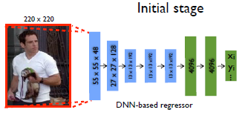

Case: Human Pose Estimation
Represent a person by K joints
Regress $(x, y)$for each joint from last fully-connected layer
(details: Normalized coordinates, iterative refinement)
Correct coordinates
head top: (x, y)
L2 Loss
left shoulder: (x, y)
L2 Loss
…
+
Loss
…
right foot: (x, y)
L2 Loss
[Toshev and Szegedy, “DeepPose: Human Pose Estimation via Deep Neural Networks”, CVPR 2014]
Computer Vision

Slide 53
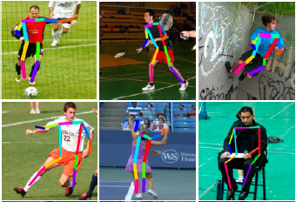
Case: Human Pose Estimation
[Toshev and Szegedy, “DeepPose: Human Pose Estimation via Deep Neural Networks”, CVPR 2014]
Computer Vision

Slide 54
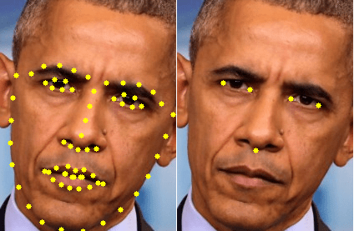
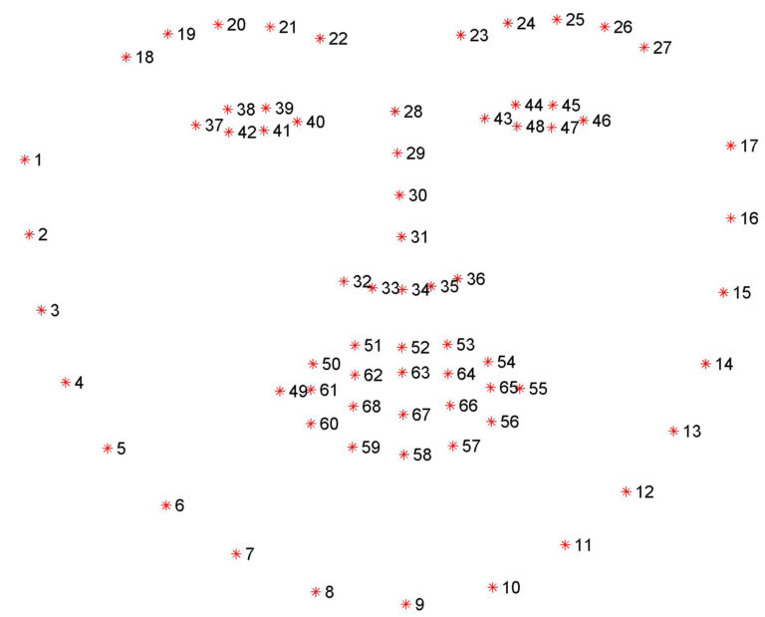
Case: Facial Landmark Detection
5 to 70 landmark points
[Toshev and Szegedy, “DeepPose: Human Pose Estimation via Deep Neural Networks”, CVPR 2014]
Computer Vision

Slide 55
Object Localization as a Regression
Very Simple
Use it
Performance wise? We need more
Computer Vision

Slide 56
Localization as Regression + Sliding Window
Computer Vision

Slide 57
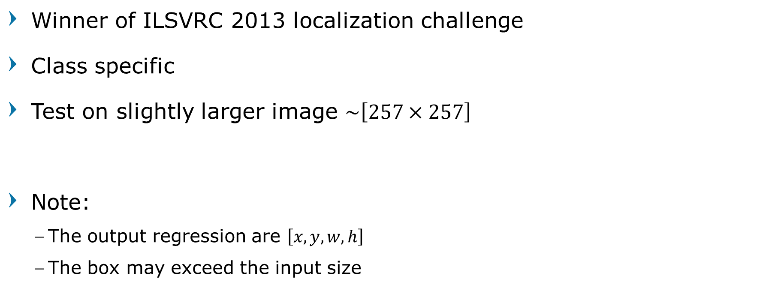
Sliding Localization: OverFeat
Winner of ILSVRC 2013 localization challenge
Class specific
Test on slightly larger image $\sim \left[257×257\right]$
Note:
The output regression are $\left[x,y,w,h\right]$
The box may exceed the input size
[Sermanet et al, “Integrated Recognition, Localization and Detection using Convolutional Networks”, ICLR 2014]
Computer Vision

Slide 58
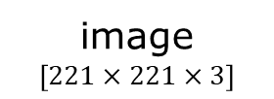

Sliding Localization: OverFeat
FC
FC
FC
Softmax loss
class scores:
1000
4096
4096
Conv
and
Pool
feature map
$$5×5×1024$$
image
$$\left[221×221×3\right]$$
FC
FC
Euclidean loss
FC
1024
Boxes:
1000 x 4
4096
[Sermanet et al, “Integrated Recognition, Localization and Detection using Convolutional Networks”, ICLR 2014]
Computer Vision

Slide 59
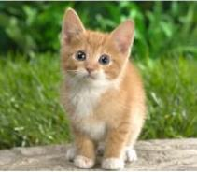
Sliding Localization: OverFeat
0.5
Classification scores
P(cat)
Network input
221 x 221 x 3
Larger image
257 x 257 x 3
[Sermanet et al, “Integrated Recognition, Localization and Detection using Convolutional Networks”, ICLR 2014]
Computer Vision

Slide 60
Sliding Localization: OverFeat
0.5
0.75
Classification scores
P(cat)
Network input
221 x 221 x 3
Larger image
257 x 257 x 3
[Sermanet et al, “Integrated Recognition, Localization and Detection using Convolutional Networks”, ICLR 2014]
Computer Vision

Slide 61
Sliding Localization: OverFeat
0.5 | 0.75
0.6
Classification scores
P(cat)
Network input
221 x 221 x 3
Larger image
257 x 257 x 3
[Sermanet et al, “Integrated Recognition, Localization and Detection using Convolutional Networks”, ICLR 2014]
Computer Vision

Slide 62
Sliding Localization: OverFeat
0.5 | 0.75
0.6
0.8
Classification scores
P(cat)
Network input
221 x 221 x 3
Larger image
257 x 257 x 3
[Sermanet et al, “Integrated Recognition, Localization and Detection using Convolutional Networks”, ICLR 2014]
Computer Vision

Slide 63
Sliding Localization: OverFeat
0.5 | 0.75
0.6 | 0.8
Classification scores
P(cat)
Network input
221 x 221 x 3
Larger image
257 x 257 x 3
Combine box prediction
[Sermanet et al, “Integrated Recognition, Localization and Detection using Convolutional Networks”, ICLR 2014]
Computer Vision

Slide 64
Sliding Localization: OverFeat
0.8
Classification scores
P(cat)
Network input
221 x 221 x 3
Larger image
257 x 257 x 3
Greedily merge boxes and scores
(details in paper)
[Sermanet et al, “Integrated Recognition, Localization and Detection using Convolutional Networks”, ICLR 2014]
Computer Vision

Slide 65
ImageNet Localization
Computer Vision

Slide 66
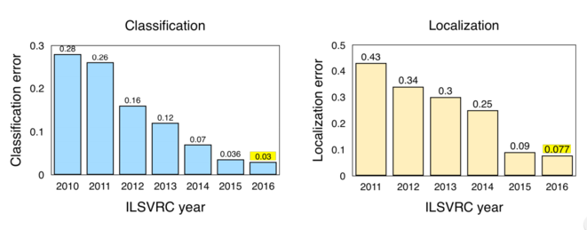
ImageNet Classification + Localization
Computer Vision

Slide 67
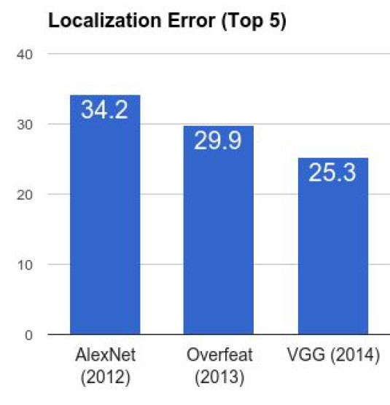
ImageNet Classification + Localization
AlexNet:
Localization method not published
Overfeat:
Multiscale convolutional regression with box merging
Computer Vision

Slide 68
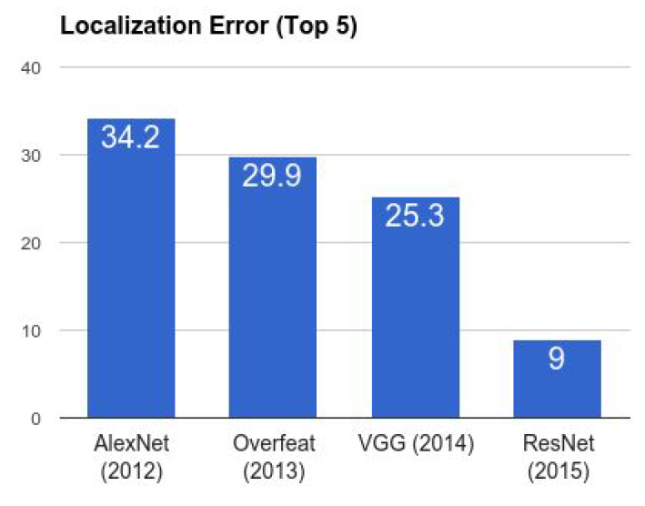
ImageNet Classification + Localization
VGG:
Same as Overfeat, but fewer scales and locations;
simpler method, gains all due to deeper features
ResNet:
Different localization method (RPN) and much deeper features
Computer Vision

Slide 69
Break, Question?
Computer Vision

